Slide 1
Biology
Unit 7: Genetics and Heredity
Lesson 1: Meiosis
Notes:
Learning Objective:

Slide 2

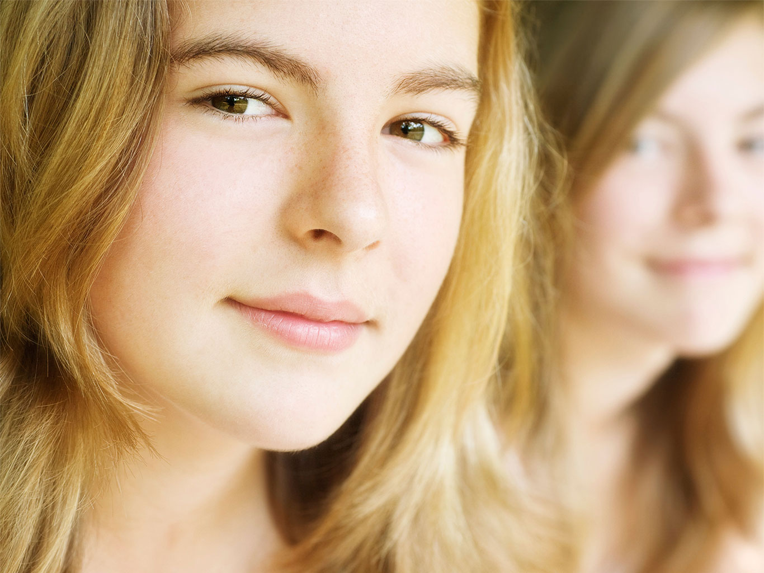
Can You Explain It?
Unit 7 Lesson 1
What do you think the chances are that there is someone in the world exactly like you?

Slide 3
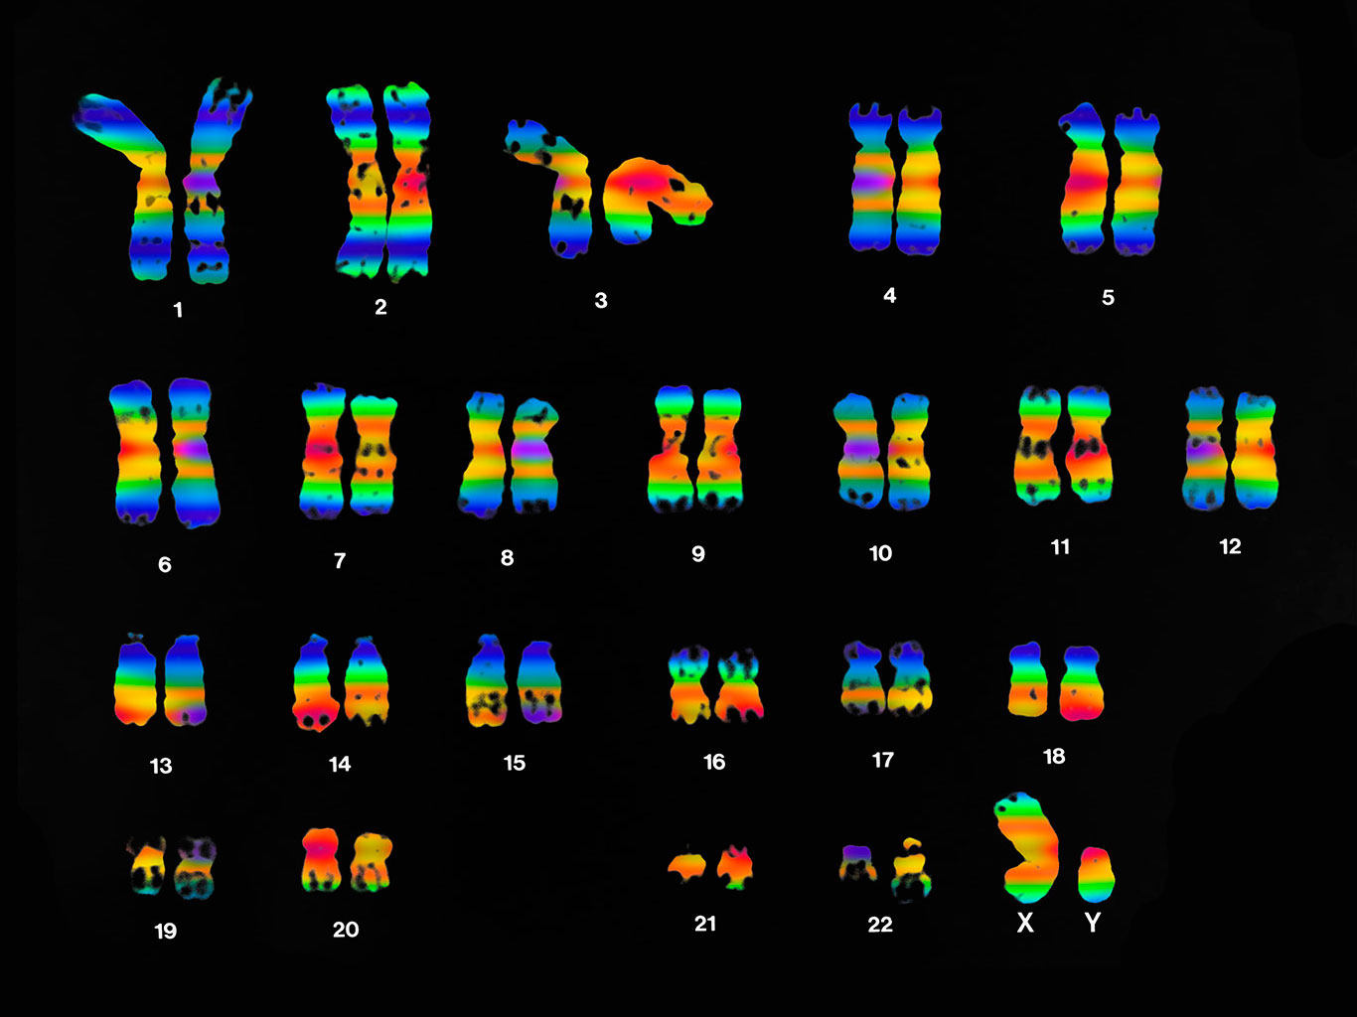
Chromosomes and Meiosis
Unit 7 Lesson 1
Chromosomes in a Human Cell.

Slide 4
Chromosomes and Meiosis
Unit 7 Lesson 1
Homologous chromosomes are two chromosomes—one inherited from the mother, one from the father—that have the same length and general appearance.
Chromosome pairs 1 through 22 makes up your autosomes, which are chromosomes that contain genes for characteristics not directly related to the sex of an organism.
Humans have two very different sex chromosomes: X and Y. In all mammals, including humans, an organism's sex is primarily determined by the XY system.

Slide 5
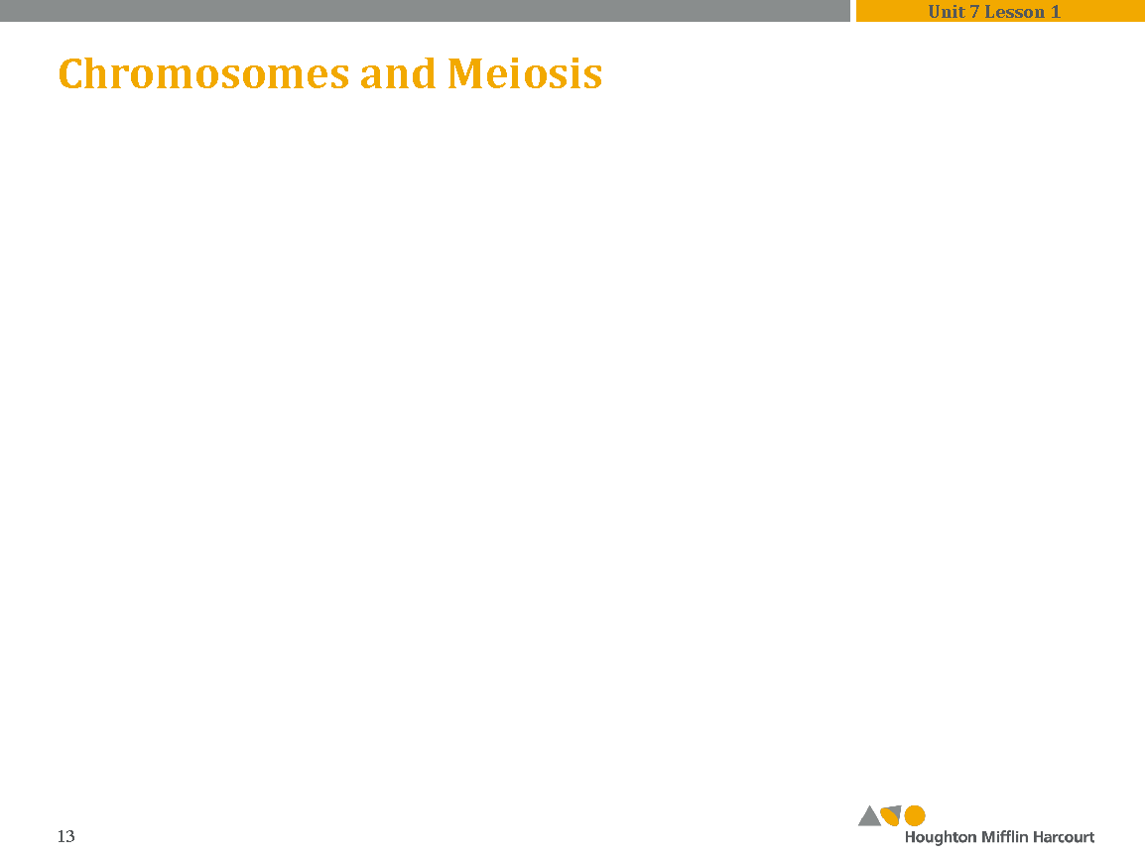
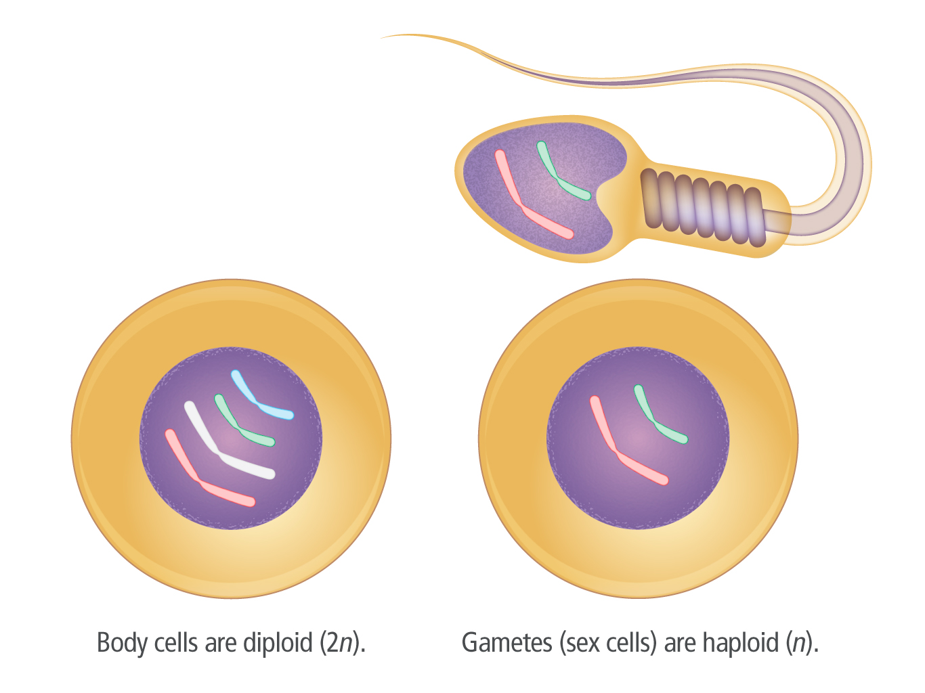
Chromosomes and Meiosis
Unit 7 Lesson 1
Unlike body cells, gametes have only one copy of each chromosome.
These cells are called haploid and can be represented as n.
Gametes include eggs and sperm.

Slide 6
Chromosomes and Meiosis
Unit 7 Lesson 1
EXPLAIN
Answer the following questions about body cells and gametes.
What is an example of a body cell in your body?
Why do gametes have half a set of DNA? What would happen if they had a full set of DNA? Explain your answer.

Slide 7
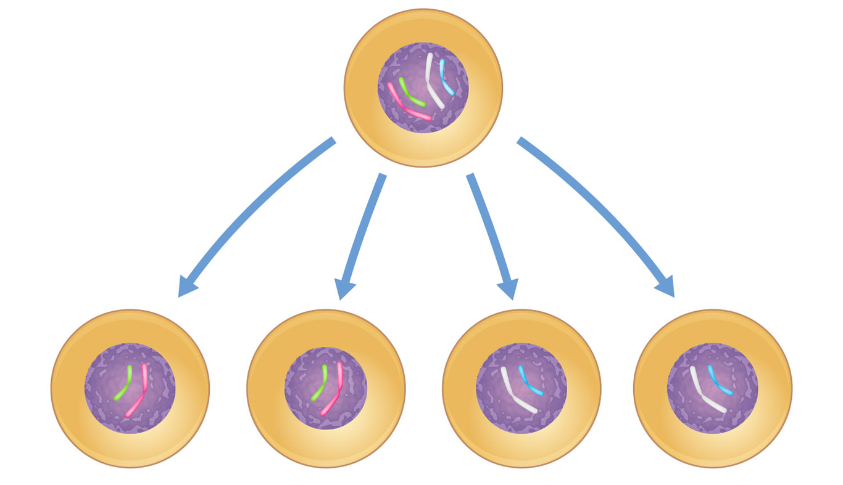
The Process of Meiosis
Unit 7 Lesson 1
Meiosis is a form of nuclear division that divides one diploid cell into four haploid cells.
In contrast, a chromatid is one half of a duplicated chromosome.

Slide 8
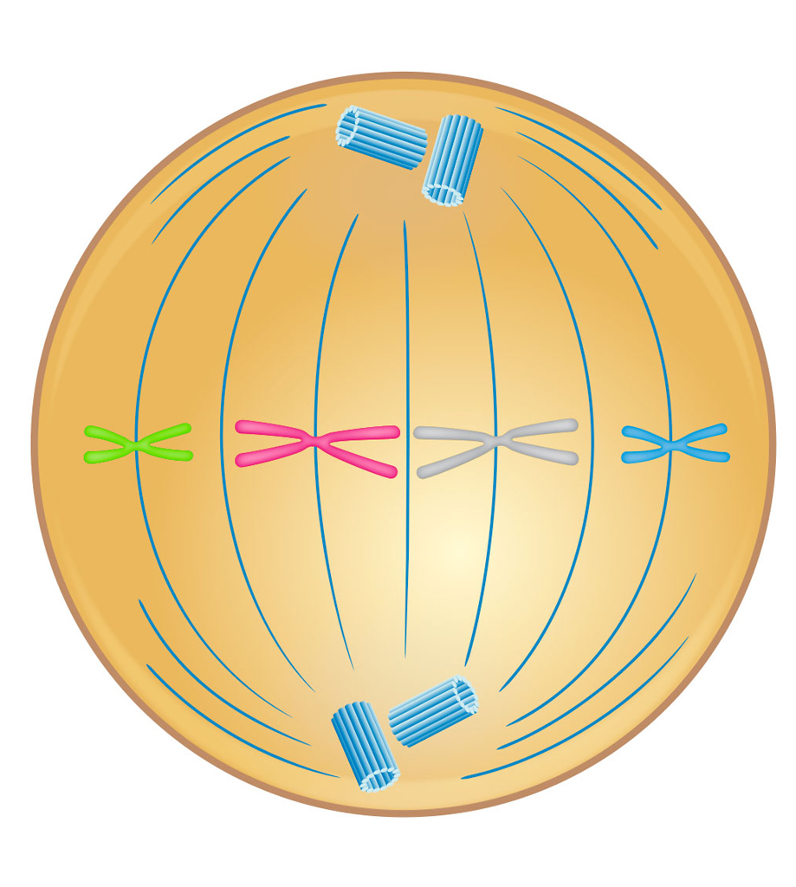
The Process of Meiosis Cause and Effect
Unit 7 Lesson 1
EXPLAIN
How do the arrangements of chromosomes in metaphase I and metaphase II of meiosis compare to each other and to the metaphase stage of mitosis?
What are the final products of mitosis and meiosis? How does the arrangement of chromosomes during metaphase affect the genetic makeup of the final products?

Slide 9

The Process of Meiosis Hands-On Activity: Modeling Meiosis
Unit 7 Lesson 1
Make a model to illustrate how the arrangement and separation of chromosomes during meiosis causes an increase in genetic diversity.

Slide 10
The Process of Meiosis
Unit 7 Lesson 1
EXPLAIN
Does meiosis or mitosis occur more frequently in your body? Explain your answer.

Slide 11
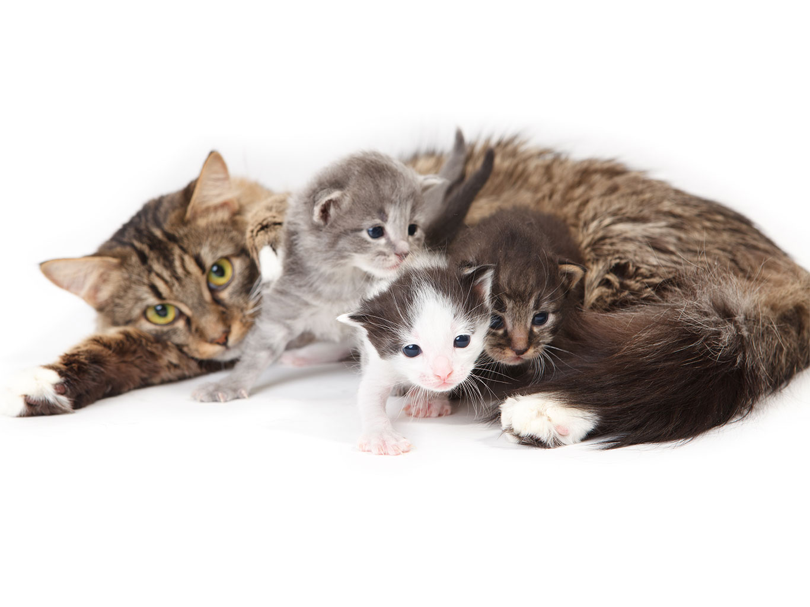
Meiosis and Genetic Variation
Unit 7 Lesson 1
Genetic variation refers to differences in the genetic material of individuals in a population.

Slide 12
Meiosis and Genetic Variation
Unit 7 Lesson 1
The arrangement of any one homologous pair does not depend on the arrangement of any other homologous pair.
Therefore, it is referred to as independent assortment.
Crossing over is the exchange of chromosome segments between homologous chromosomes.

Slide 13
Meiosis and Genetic Variation
Unit 7 Lesson 1
EXPLAIN
Use what you have learned about meiosis and sexual reproduction to construct an explanation for why offspring are not exact replicas of their parents. In your answer, include a discussion of sexual reproduction, independent assortment, and crossing over.

Slide 14
Unit 7 Lesson 1
Continue Your Exploration
Choose one of the paths below to continue your exploration:
Investigating Genetic Linkage
Gene Duplication in Plants
Gathering Evidence for Genetic Diversity

Slide 15
Can You Explain It?
Unit 7 Lesson 1
In general, how likely is it that there is someone in the world who is genetically identical to you? Your explanation should include a discussion of sexual reproduction, meiosis, crossing over, and independent assortment.
State your claim.
Cite evidence to support your claim. Include models and examples as necessary.
Explain how the evidence you cited supports your claim. For example, consider the number of possible chromosome combinations made by independent assortment. How would this evidence support the statement you are making?

Slide 16
Image Credits
Unit 7 Lesson 1
DNA sample ©Volker Steger/Science Source; DNA computer model Image of PDB entry 3L4V created with Chimera (http://www.rbvi.ucsf.edu/chimera/); two girls ©Design Pics Inc./Alamy; karyotype ©Biophoto Associates/Colorization by: Mary Martin/Science Source; cat and kittens ©Leonidovich/Fotolia

